Slide 1
Lab 8: VAST package
May 17, 2018
Learning objectives:
Interpret multivariate spatio-temporal model results
Gain familiarity with VAST package

Slide 2
Can biogenic habitat be a “proxy” for rockfish habitat?
Steps:
Obtain bottom-trawl data for 8 rockfishes and biogenic habitat (soft corals + sponges)
Fit multispecies model
Interpret covariation
Compare single-species multispecies index of abundance
Thorson, and Barnett. 2017. Comparing estimates of abundance trends and distribution shifts using single- and multispecies models of fishes and biogenic habitat. ICES J. Mar. Sci. J. Cons.

Slide 3
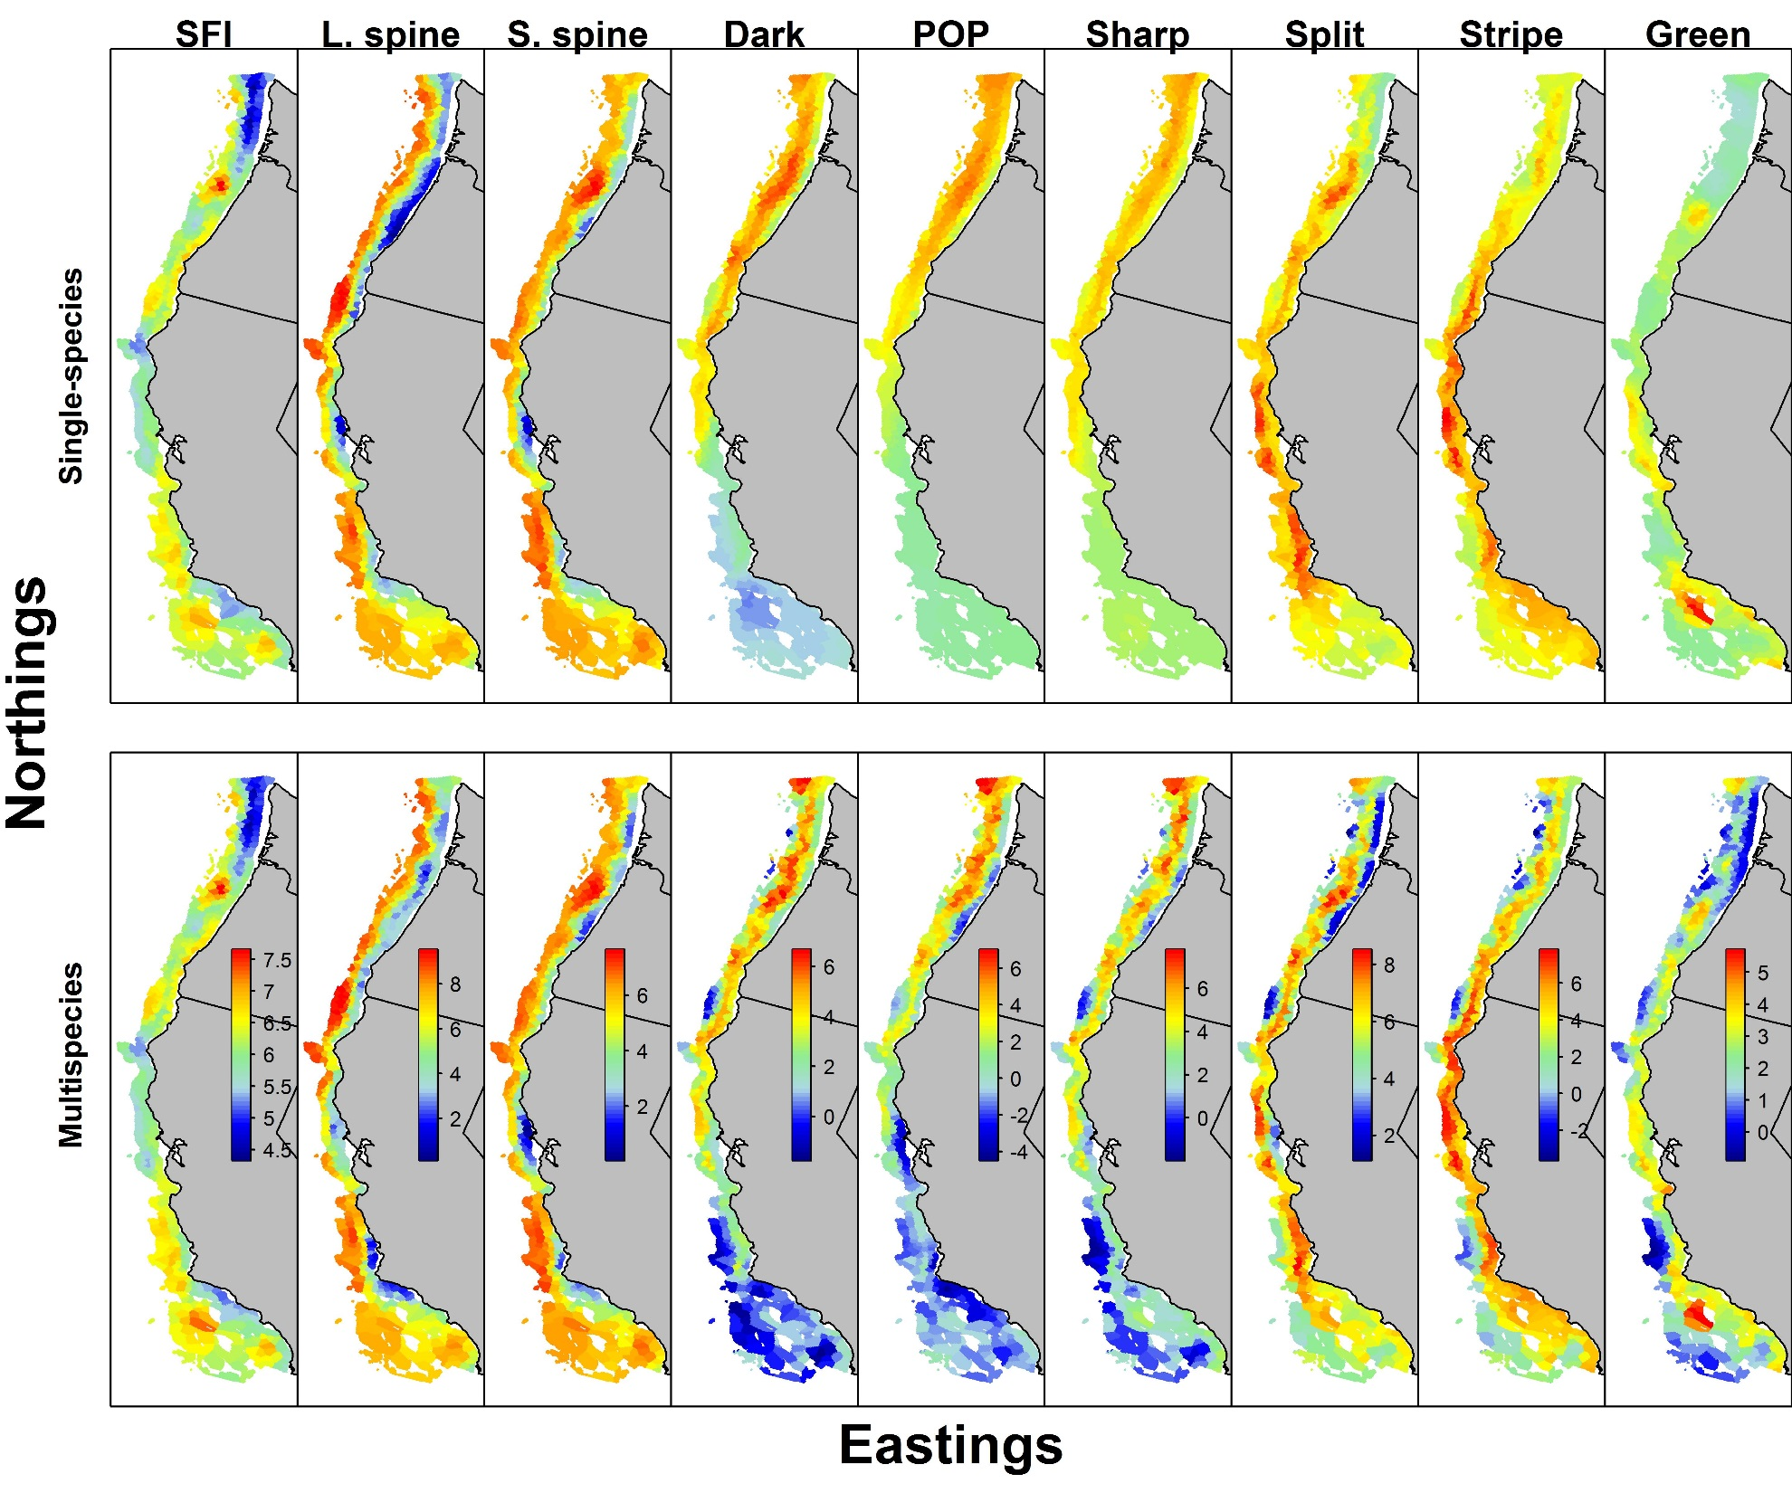
Can biogenic habitat be a “proxy” for rockfish habitat?
Single-species models are strongly smoothed
No fine-scale information for splitnose and sharpchin

Slide 4
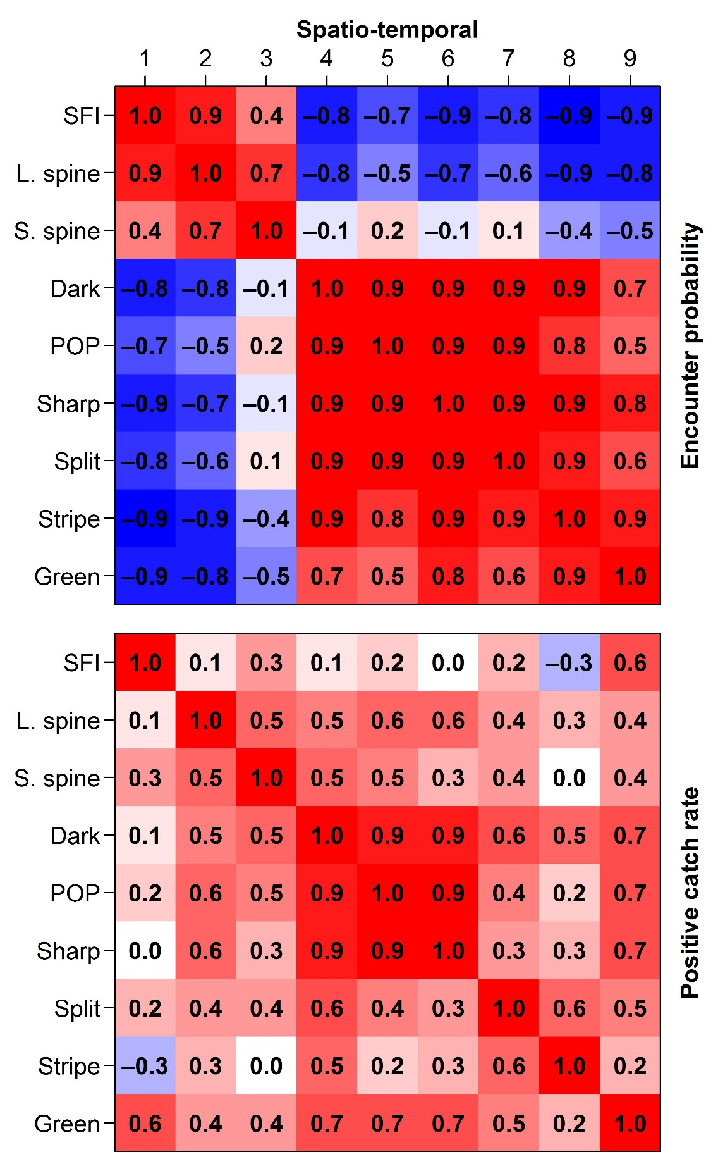

Covariance for spatio-temporal components of encounter probability and positive catch rates
Encounter probability shows two groups
SFI + Thornyheads VS rockfishes
Positive catch rate shows three groups
SFI + Thornyheads VS Northern rockfishes VS Coastwide rockfishes
Correlation: Encounter probability
Correlation: Positive catch rates

Slide 5
Can biogenic habitat be a “proxy” for rockfish habitat?
Multispecies model captures fine-scale variation
Shrinks stripetail towards greenstriped
Shrinks POP towards sharpchin

Slide 6
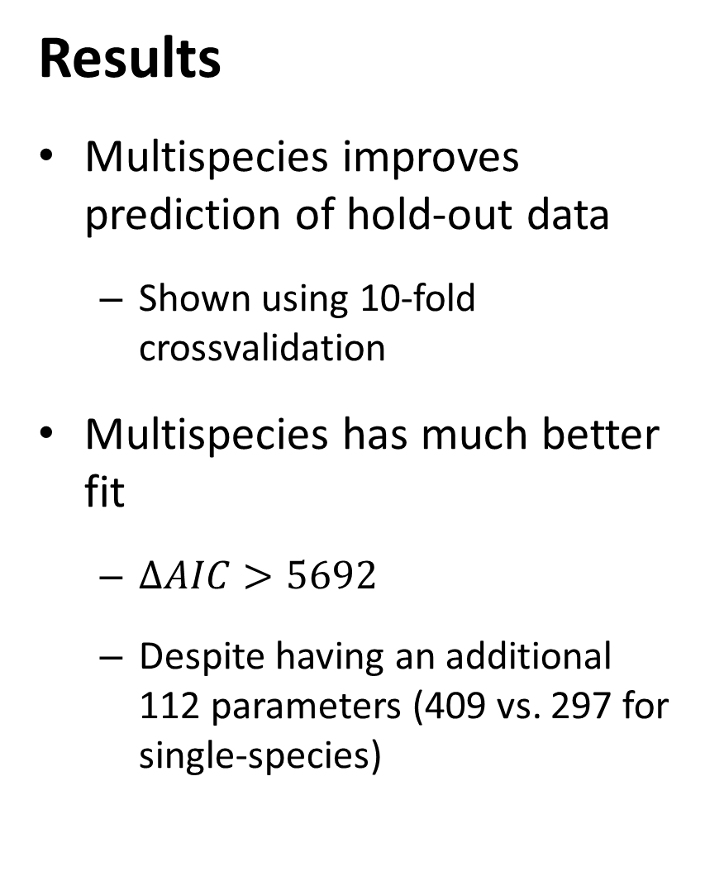
Results
Multispecies improves prediction of hold-out data
Shown using 10-fold crossvalidation
Multispecies has much better fit
$∆AIC>5692$
Despite having an additional 112 parameters (409 vs. 297 for single-species)
10-fold crossvalidation exercise
# | Predictive negative log-likelihood |  | Ratio of predictive probability
 | Single-species VAST model | Multispecies VAST model
1 | 8459.71 | 8078.84 | 1.057
2 | 8560.26 | 8209.90 | 1.053
3 | 8768.53 | 8377.45 | 1.059
4 | 8203.66 | 7815.19 | 1.058
5 | 8335.34 | 8009.96 | 1.049
6 | 8548.48 | 8154.91 | 1.059
7 | 8426.61 | 8133.02 | 1.044
8 | 8688.89 | 8335.62 | 1.052
9 | 8439.27 | 8077.01 | 1.055
10 | 8594.30 | 8271.42 | 1.048

Slide 7
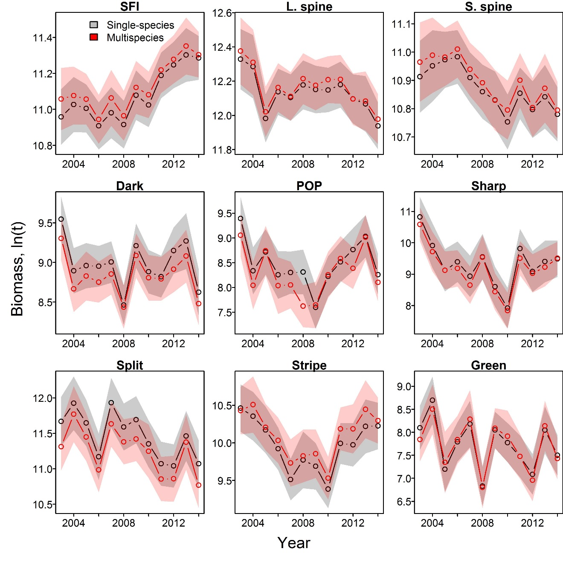
Results
Multispecies model doesn’t shrink intervals
Single-species has very similar standard errors
Indices are largely similar between methods
Makes sense given fixed index for every species-year
Indices of abundance for each species in analysis

Slide 8
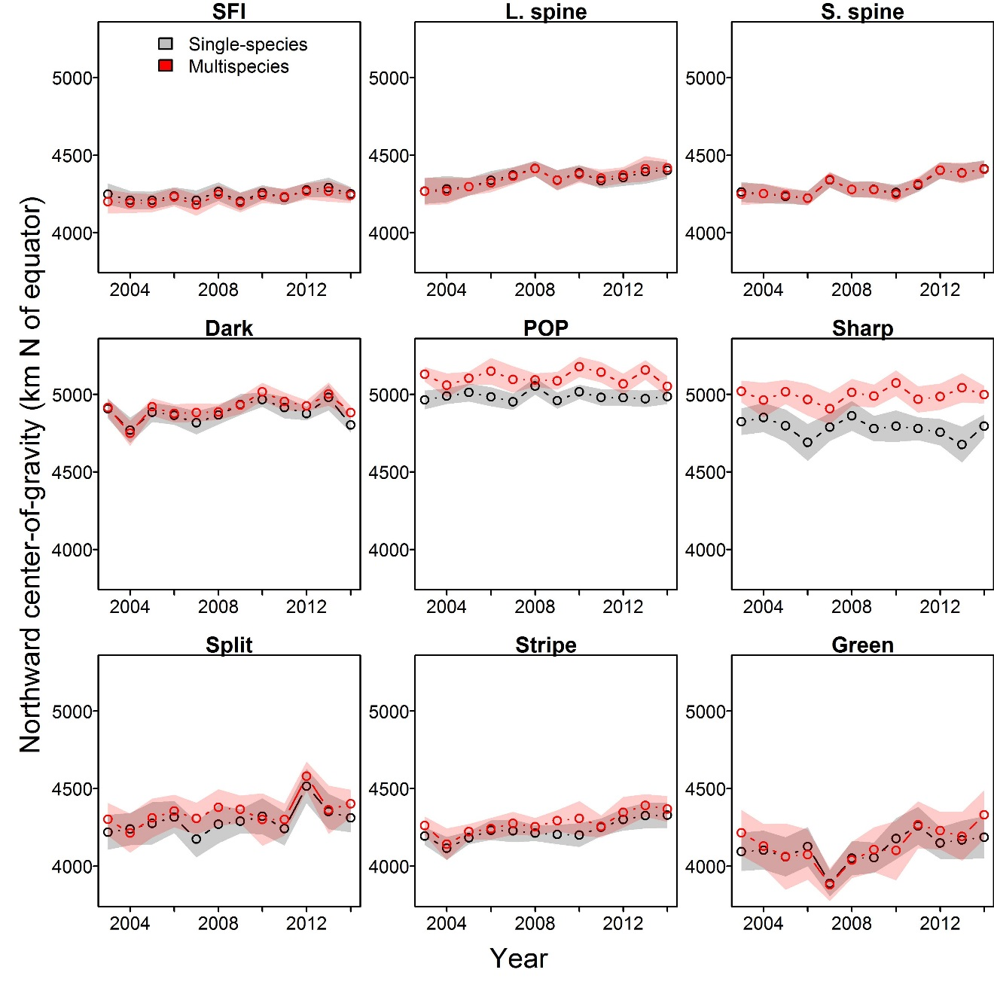
Results
Multispecies model again doesn’t shrink intervals
Multispecies shrinks species towards their group
Large change in COG for POP and sharpchin
Center-of-gravity (km north of equator) for each species

Slide 9
Recommendations
Multispecies model is useful for…
Understanding covariation among species
Useful information ecologically
Essential fish habitat designation
Improves density predictions
Multispecies model is not useful for…
Index standardization for stock assessment
Adds complexity without improvement in precision
Climate-impact analysis
Too sensitive to model-specification for sensitive science issues

Slide 10
VAST package and FishStats toolbox
Spatio-temporal model
Benefits of single approach
Include biological mechanism
Improved communication
Similar review standards and “burden of proof”
Stock Assessment
Habitat Assessment
Integrated ecosystem assessment
Climate Assessment

Slide 11

VAST package and FishStats toolbox
www.FishStats.org
FishViz
Visualizes results worldwide
VAST
Multi-species index model
SpatialVAM
Estimate species interactions
FishData
Scrape data worldwide
FishStats-listserv
Community updates by email

Slide 12
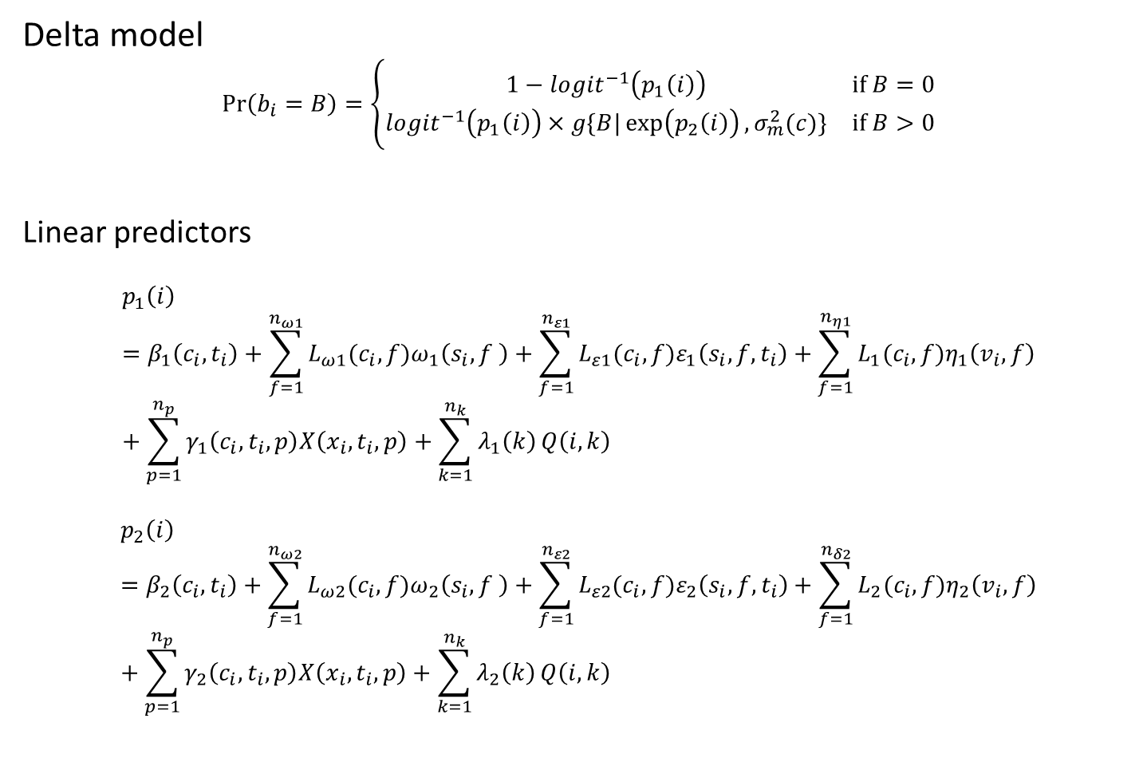
VAST package and FishStats toolbox
Delta model
$$\operatorname{Pr}\left(b_{i}=B\right)=\left\{\begin{matrix}1−logit^{−1}\left(p_{1}\left(i\right)\right) & if B=0 \\ logit^{−1}\left(p_{1}\left(i\right)\right)×g\{\left.B|\exp\left(p_{2}\left(i\right)\right),σ_{m}^{2}(c)\}\right. & if B>0\end{matrix}\right.$$
Linear predictors
$$p_{1}\left(i\right)=β_{1}\left(c_{i},t_{i}\right)+\sum_{f=1}^{n_{ω1}}{L_{ω1}(c_{i}, f)ω_{1}\left(s_{i},f \right)}+\sum_{f=1}^{n_{ε1}}{L_{ε1}(c_{i}, f)ε_{1}\left(s_{i},f,t_{i}\right)}+\sum_{f=1}^{n_{η1}}{L_{1}(c_{i},f)η_{1}\left(v_{i},f\right)}+\sum_{p=1}^{n_{p}}{γ_{1}\left(c_{i}, t_{i},p\right)X\left(x_{i},t_{i},p\right)+\sum_{k=1}^{n_{k}}{λ_{1}\left(k\right)}Q\left(i,k\right)}$$
$$p_{2}\left(i\right)=β_{2}\left(c_{i},t_{i}\right)+\sum_{f=1}^{n_{ω2}}{L_{ω2}(c_{i}, f)ω_{2}\left(s_{i},f \right)}+\sum_{f=1}^{n_{ε2}}{L_{ε2}(c_{i}, f)ε_{2}\left(s_{i},f,t_{i}\right)}+\sum_{f=1}^{n_{δ2}}{L_{2}(c_{i},f)η_{2}\left(v_{i},f\right)}+\sum_{p=1}^{n_{p}}{γ_{2}\left(c_{i}, t_{i},p\right)X\left(x_{i},t_{i},p\right)}+\sum_{k=1}^{n_{k}}{λ_{2}\left(k\right)}Q\left(i,k\right)$$

Slide 13
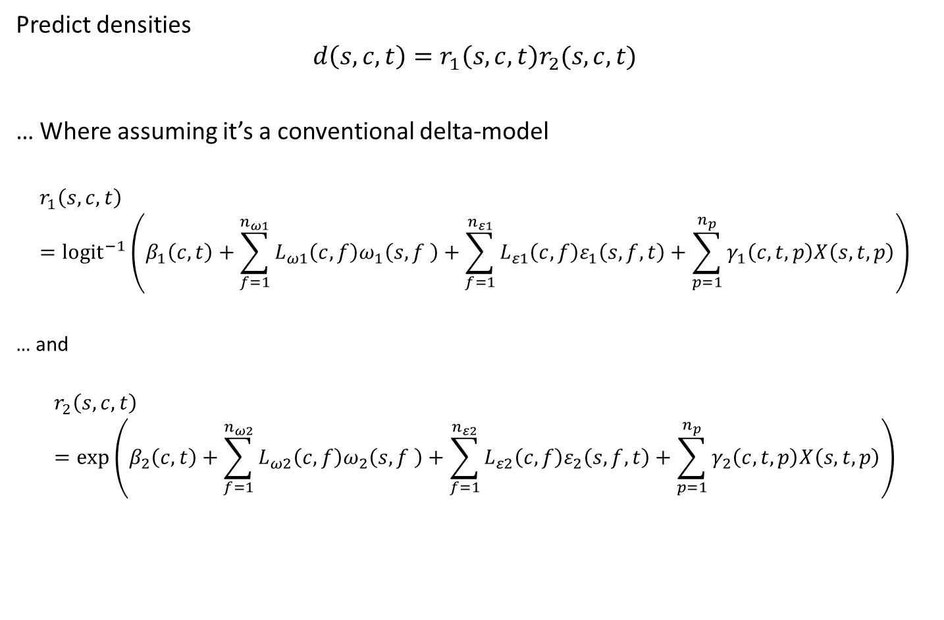
VAST package and FishStats toolbox
Predict densities
$$d\left(s,c,t\right)=r_{1}\left(s,c,t\right)r_{2}(s,c,t)$$
… Where assuming it’s a conventional delta-model
$$r_{1}\left(s,c,t\right)={logit}^{−1}\left(β_{1}\left(c,t\right)+\sum_{f=1}^{n_{ω1}}{L_{ω1}\left(c, f\right)ω_{1}\left(s,f \right)}+\sum_{f=1}^{n_{ε1}}{L_{ε1}\left(c, f\right)ε_{1}\left(s,f,t\right)}+\sum_{p=1}^{n_{p}}{γ_{1}\left(c,t,p\right)X\left(s,t,p\right)}\right)$$
… and
$$r_{2}\left(s,c,t\right)=\exp\left(β_{2}\left(c,t\right)+\sum_{f=1}^{n_{ω2}}{L_{ω2}\left(c, f\right)ω_{2}\left(s,f \right)}+\sum_{f=1}^{n_{ε2}}{L_{ε2}\left(c, f\right)ε_{2}\left(s,f,t\right)}+\sum_{p=1}^{n_{p}}{γ_{2}\left(c,t,p\right)X\left(s,t,p\right)}\right)$$

Slide 14
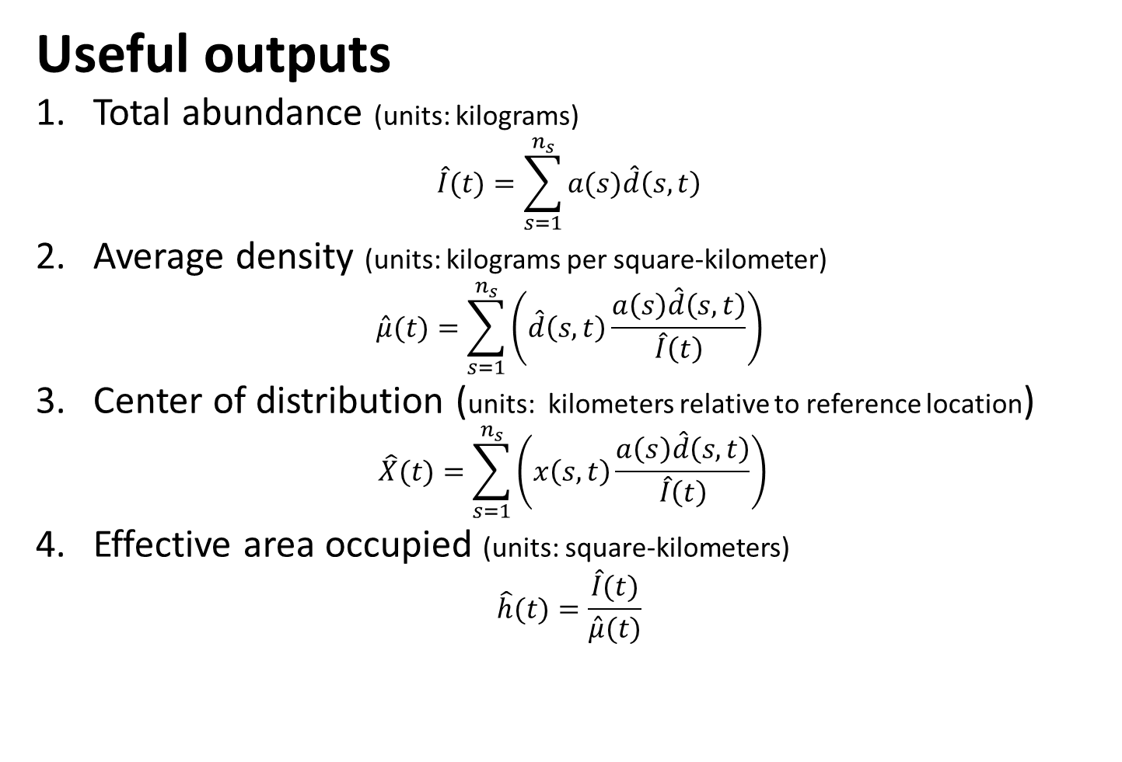
VAST package and FishStats toolbox
Useful outputs
1. Total abundance (units: kilograms)
$$\hat{I}(t)=\sum_{s=1}^{n_{s}}{a(s)\hat{d}\left(s,t\right)}$$
2. Average density (units: kilograms per square-kilometer)
$$\hat{μ}(t)=\sum_{s=1}^{n_{s}}{\left(\hat{d}\left(s,t\right)\frac{a\left(s\right)\hat{d}\left(s,t\right)}{\hat{I}\left(t\right)}\right)}$$
3. Center of distribution (units: kilometers relative to reference location)
$$\hat{X}(t)=\sum_{s=1}^{n_{s}}{\left(x\left(s,t\right)\frac{a\left(s\right)\hat{d}\left(s,t\right)}{\hat{I}\left(t\right)}\right)}$$
4. Effective area occupied (units: square-kilometers)
$$\hat{h}(t)=\frac{\hat{I}(t)}{\hat{μ}(t)}$$

Slide 15
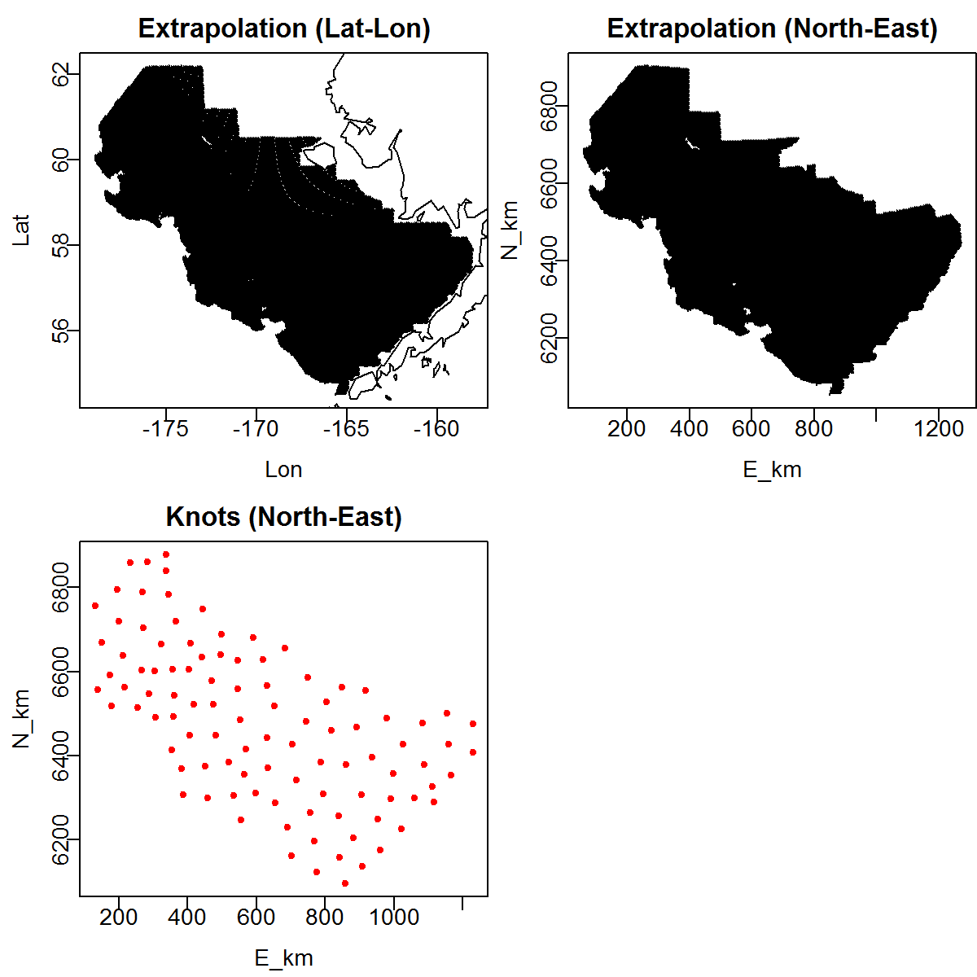
Diagnostics
Advice: Inspect extrapolation footprint and knots

Slide 16
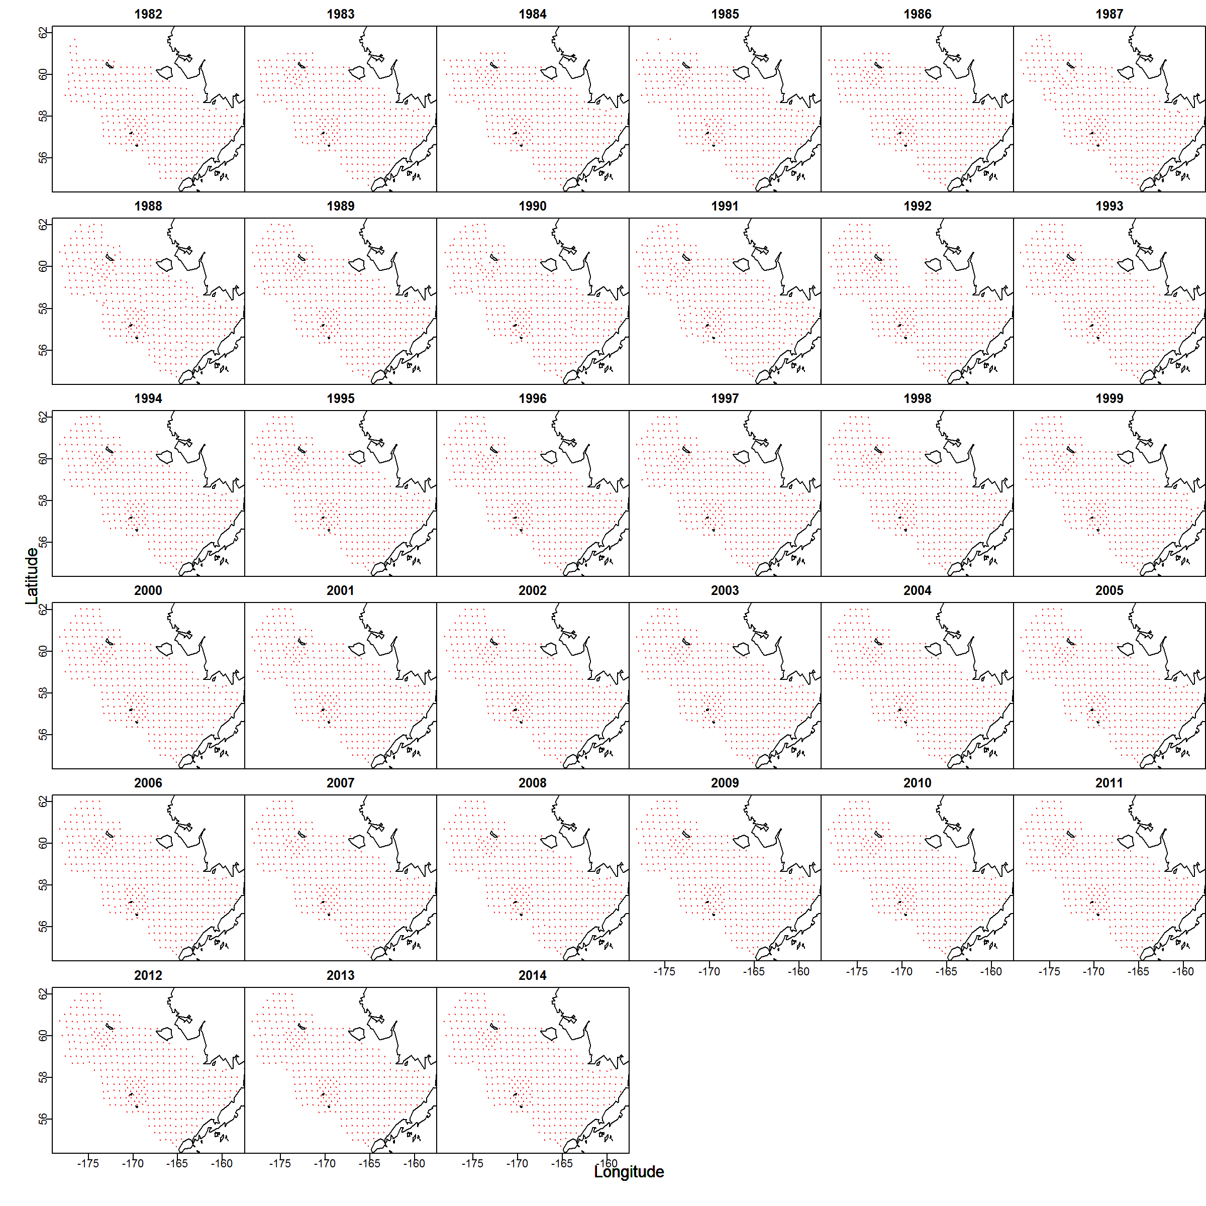
Diagnostics
Advice: Inspect spatial distribution of data

Slide 17
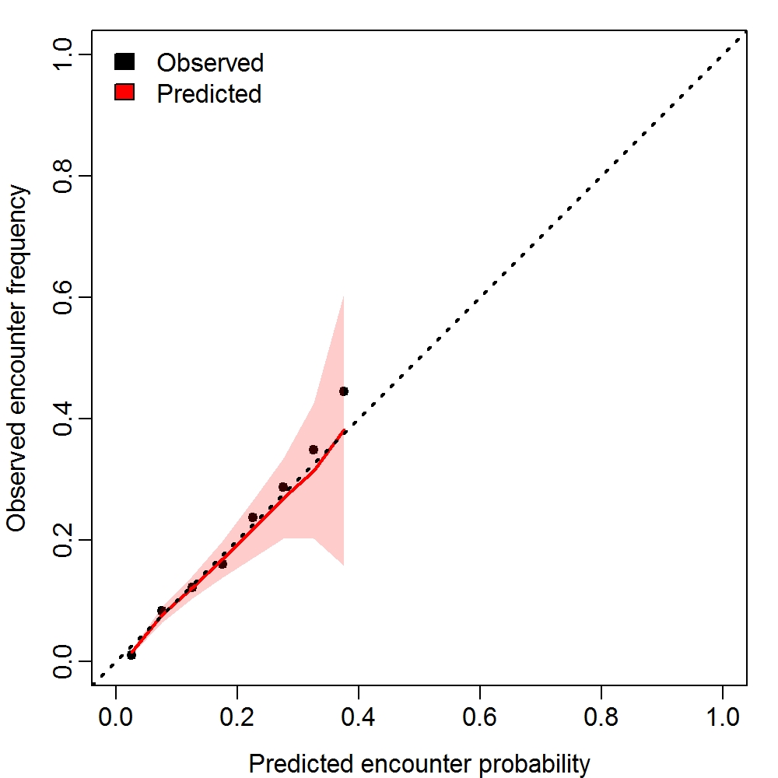
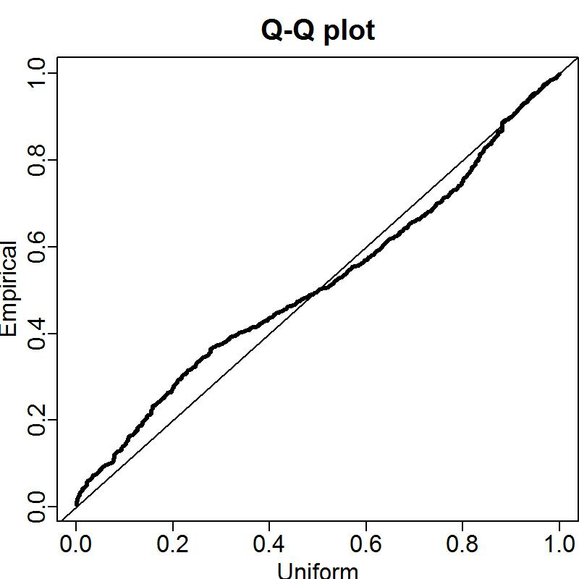
Diagnostics
Encounter probability vs. frequency
Quantile-quantile plot for positive catch rates

Slide 18
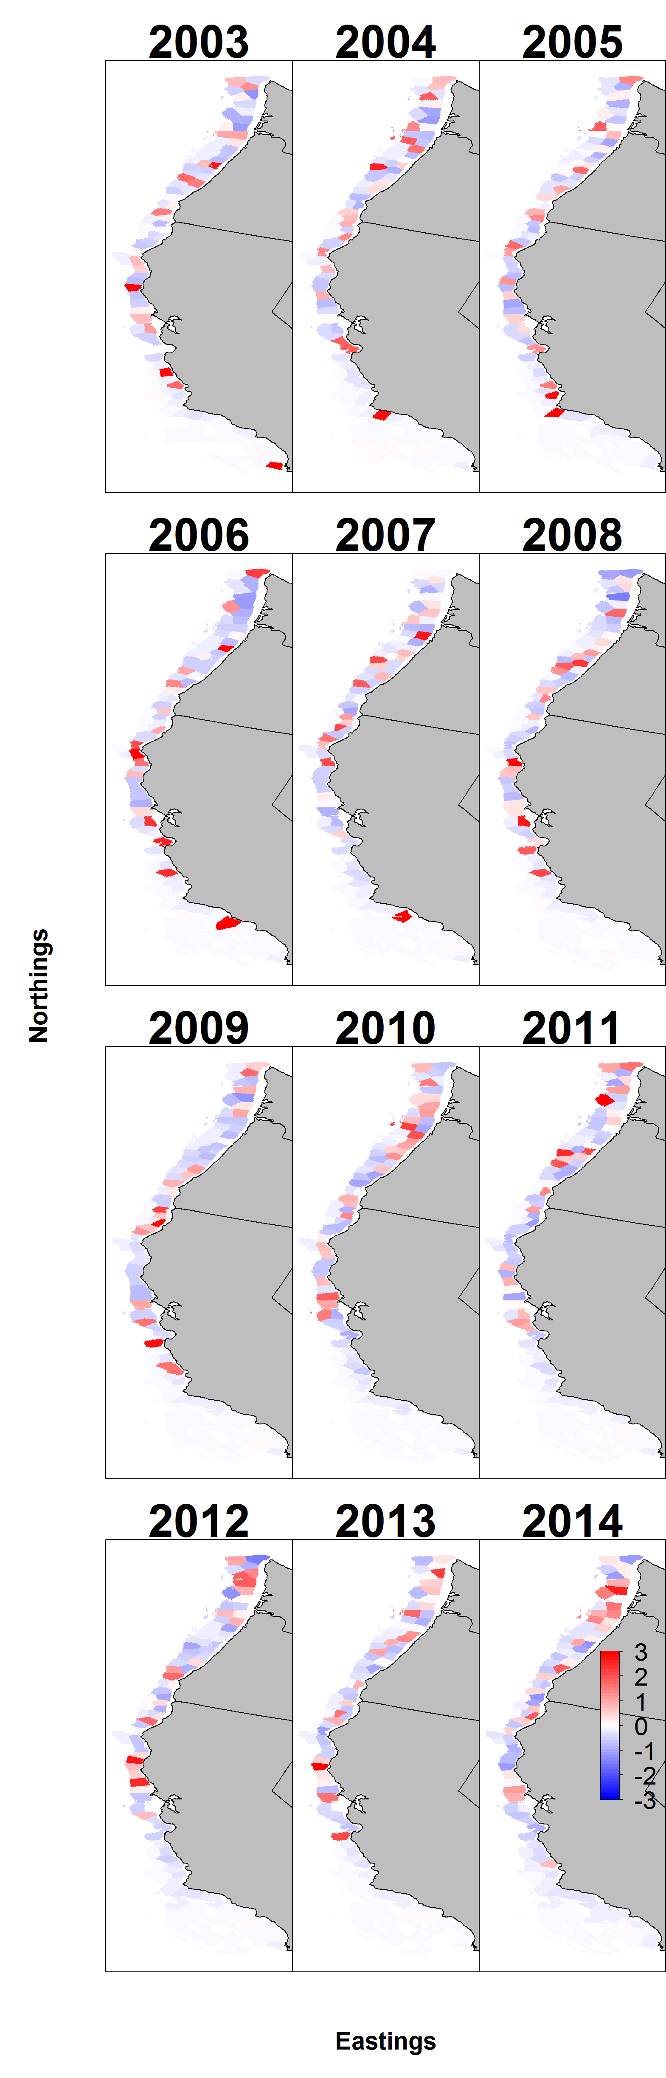
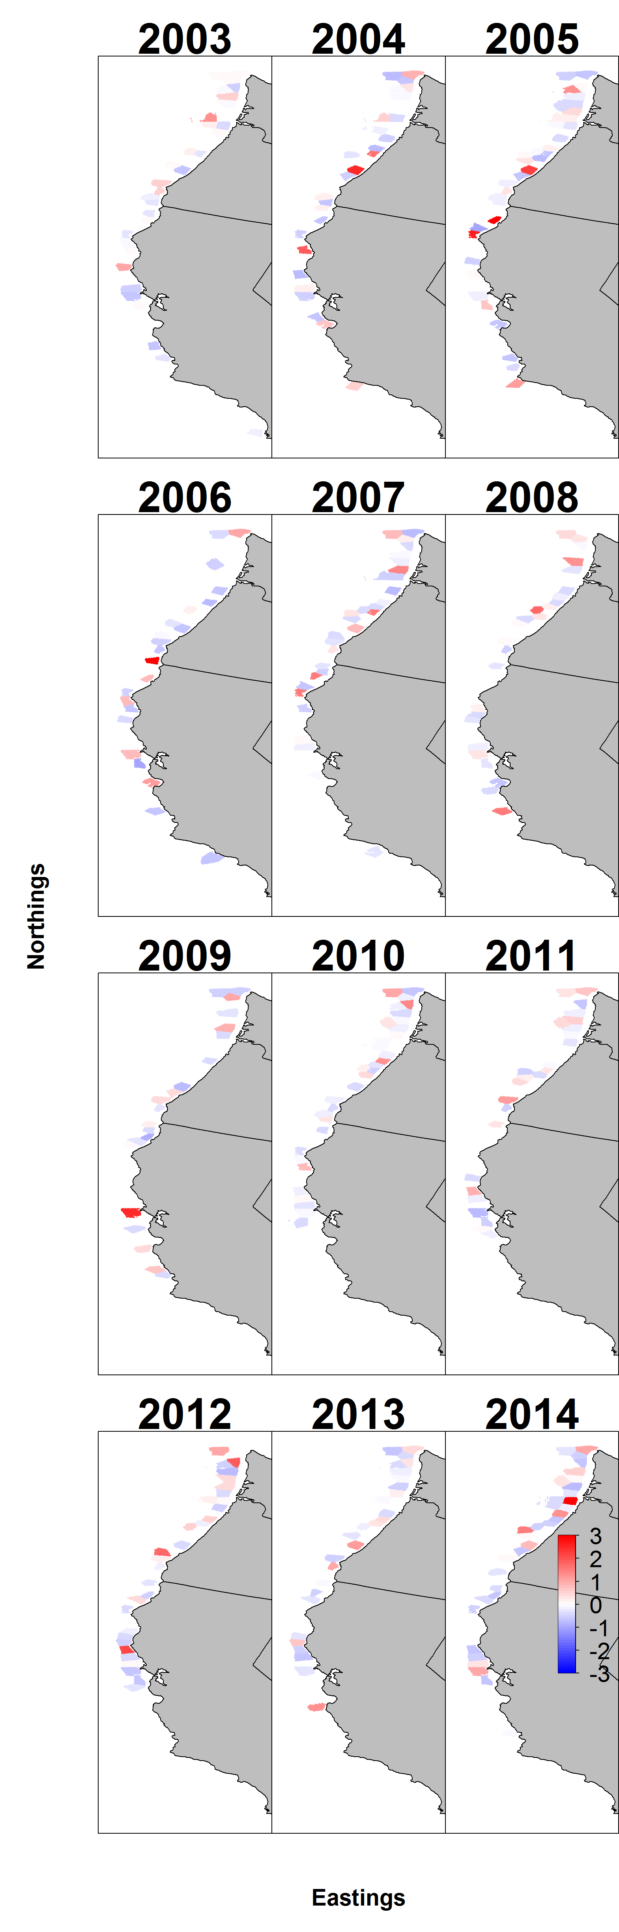
Pearson residuals for encounter
Pearson residuals for positive catch rates

Slide 19
Advice – Look at bounds and gradients
 | Param | starting_value | Lower | MLE | Upper | final_gradient
39 | beta2_ct | 9.21962 | -50 | 7.516834 | 50 | 2.20E-10
40 | beta2_ct | 9.21962 | -50 | 8.739776 | 50 | -1.49E-10
41 | beta2_ct | 9.21962 | -50 | 7.843733 | 50 | 1.06E-09
42 | beta2_ct | 9.21962 | -50 | 8.534672 | 50 | 1.02E-09
43 | beta2_ct | 9.21962 | -50 | 8.097048 | 50 | 1.03E-09
44 | beta2_ct | 9.21962 | -50 | 8.458756 | 50 | 3.47E-10
45 | beta2_ct | 9.21962 | -50 | 8.286936 | 50 | -1.06E-10
46 | beta2_ct | 9.21962 | -50 | 8.242662 | 50 | 2.49E-11
47 | beta2_ct | 9.21962 | -50 | 8.045717 | 50 | 9.28E-10
48 | beta2_ct | 9.21962 | -50 | 8.170187 | 50 | 3.41E-11
49 | beta2_ct | 9.21962 | -50 | 8.06304 | 50 | 9.76E-10
50 | beta2_ct | 9.21962 | -50 | 8.212494 | 50 | -5.63E-10
51 | beta2_ct | 9.21962 | -50 | 8.008228 | 50 | -1.80E-10
52 | beta2_ct | 9.21962 | -50 | 7.516414 | 50 | -7.77E-10
53 | beta2_ct | 9.21962 | -50 | 7.730084 | 50 | -2.10E-10
54 | beta2_ct | 9.21962 | -50 | 7.886746 | 50 | 2.17E-10
55 | beta2_ct | 9.21962 | -50 | 7.662614 | 50 | -5.12E-10
56 | beta2_ct | 9.21962 | -50 | 7.40508 | 50 | 7.91E-10
57 | beta2_ct | 9.21962 | -50 | 8.197652 | 50 | -7.12E-10
58 | beta2_ct | 9.21962 | -50 | 8.165989 | 50 | -2.23E-10
59 | beta2_ct | 9.21962 | -50 | 7.847344 | 50 | -2.63E-09
60 | beta2_ct | 9.21962 | -50 | 8.542195 | 50 | 1.28E-10
61 | beta2_ct | 9.21962 | -50 | 7.982901 | 50 | -1.07E-09
62 | beta2_ct | 9.21962 | -50 | 7.832611 | 50 | -4.09E-10
63 | beta2_ct | 9.21962 | -50 | 7.129841 | 50 | -1.78E-10
64 | beta2_ct | 9.21962 | -50 | 6.996498 | 50 | 4.58E-10
65 | beta2_ct | 9.21962 | -50 | 6.544465 | 50 | -1.44E-09
66 | beta2_ct | 9.21962 | -50 | 6.056259 | 50 | 8.04E-10
67 | beta2_ct | 9.21962 | -50 | 7.290846 | 50 | 1.02E-09
68 | beta2_ct | 9.21962 | -50 | 7.545933 | 50 | 5.06E-10
69 | beta2_ct | 9.21962 | -50 | 7.247531 | 50 | -1.24E-09
70 | beta2_ct | 9.21962 | -50 | 7.513136 | 50 | 1.12E-09
71 | beta2_ct | 9.21962 | -50 | 8.565377 | 50 | -9.49E-10
72 | L_omega2_z | -0.58178 | -50 | -1.10638 | 50 | -9.35E-09
73 | L_epsilon2_z | -0.45241 | -50 | -1.12348 | 50 | 1.43E-07
74 | logkappa2 | -0.10536 | -6.01012 | -4.53498 | -2.57395 | 3.22E-08
75 | logSigmaM | 1.609438 | -50 | 0.168158 | 10 | -2.42E-07
 | Param | starting_value | Lower | MLE | Upper | final_gradient
1 | ln_H_input | 0 | -50 | 0.231528 | 50 | -6.19E-08
2 | ln_H_input | 0 | -50 | -0.96568 | 50 | -8.88E-08
3 | beta1_ct | -4.64096 | -50 | 4.120475 | 50 | 2.44E-09
4 | beta1_ct | -4.64096 | -50 | 4.228782 | 50 | 1.90E-09
5 | beta1_ct | -4.64096 | -50 | 4.322799 | 50 | -5.30E-10
6 | beta1_ct | -4.64096 | -50 | 5.093036 | 50 | 4.60E-09
7 | beta1_ct | -4.64096 | -50 | 5.428053 | 50 | -5.17E-08
8 | beta1_ct | -4.64096 | -50 | 4.105238 | 50 | -2.95E-09
9 | beta1_ct | -4.64096 | -50 | 5.056347 | 50 | 4.29E-09
10 | beta1_ct | -4.64096 | -50 | 4.168261 | 50 | -5.53E-09
11 | beta1_ct | -4.64096 | -50 | 4.333523 | 50 | 7.79E-09
12 | beta1_ct | -4.64096 | -50 | 5.989274 | 50 | -1.02E-08
13 | beta1_ct | -4.64096 | -50 | 4.524008 | 50 | 3.45E-09
14 | beta1_ct | -4.64096 | -50 | 5.265399 | 50 | 3.09E-09
15 | beta1_ct | -4.64096 | -50 | 5.646847 | 50 | -9.95E-11
16 | beta1_ct | -4.64096 | -50 | 4.886118 | 50 | 3.52E-09
17 | beta1_ct | -4.64096 | -50 | 5.073619 | 50 | 4.40E-09
18 | beta1_ct | -4.64096 | -50 | 4.753279 | 50 | 5.61E-09
19 | beta1_ct | -4.64096 | -50 | 4.996536 | 50 | 4.81E-09
20 | beta1_ct | -4.64096 | -50 | 6.218751 | 50 | 1.38E-09
21 | beta1_ct | -4.64096 | -50 | 5.124685 | 50 | -3.66E-09
22 | beta1_ct | -4.64096 | -50 | 5.706784 | 50 | -8.00E-09
23 | beta1_ct | -4.64096 | -50 | 4.80919 | 50 | 4.36E-09
24 | beta1_ct | -4.64096 | -50 | 4.534566 | 50 | 6.15E-09
25 | beta1_ct | -4.64096 | -50 | 5.45406 | 50 | -1.36E-09
26 | beta1_ct | -4.64096 | -50 | 4.746618 | 50 | 4.78E-09
27 | beta1_ct | -4.64096 | -50 | 4.572286 | 50 | 8.21E-09
28 | beta1_ct | -4.64096 | -50 | 4.198098 | 50 | 1.19E-08
29 | beta1_ct | -4.64096 | -50 | 2.877037 | 50 | 1.34E-08
30 | beta1_ct | -4.64096 | -50 | 3.426151 | 50 | 8.29E-09
31 | beta1_ct | -4.64096 | -50 | 2.986486 | 50 | 5.37E-09
32 | beta1_ct | -4.64096 | -50 | 4.659832 | 50 | 4.15E-09
33 | beta1_ct | -4.64096 | -50 | 4.656848 | 50 | 7.09E-09
34 | beta1_ct | -4.64096 | -50 | 5.18952 | 50 | 4.60E-09
35 | beta1_ct | -4.64096 | -50 | 6.231048 | 50 | 1.60E-09
36 | L_omega1_z | -0.83795 | -50 | -1.94641 | 50 | 1.61E-07
37 | L_epsilon1_z | 1.037078 | -50 | 0.975252 | 50 | -3.53E-07
38 | logkappa1 | -0.10536 | -6.01012 | -4.12041 | -2.57395 | 4.33E-07

Slide 20
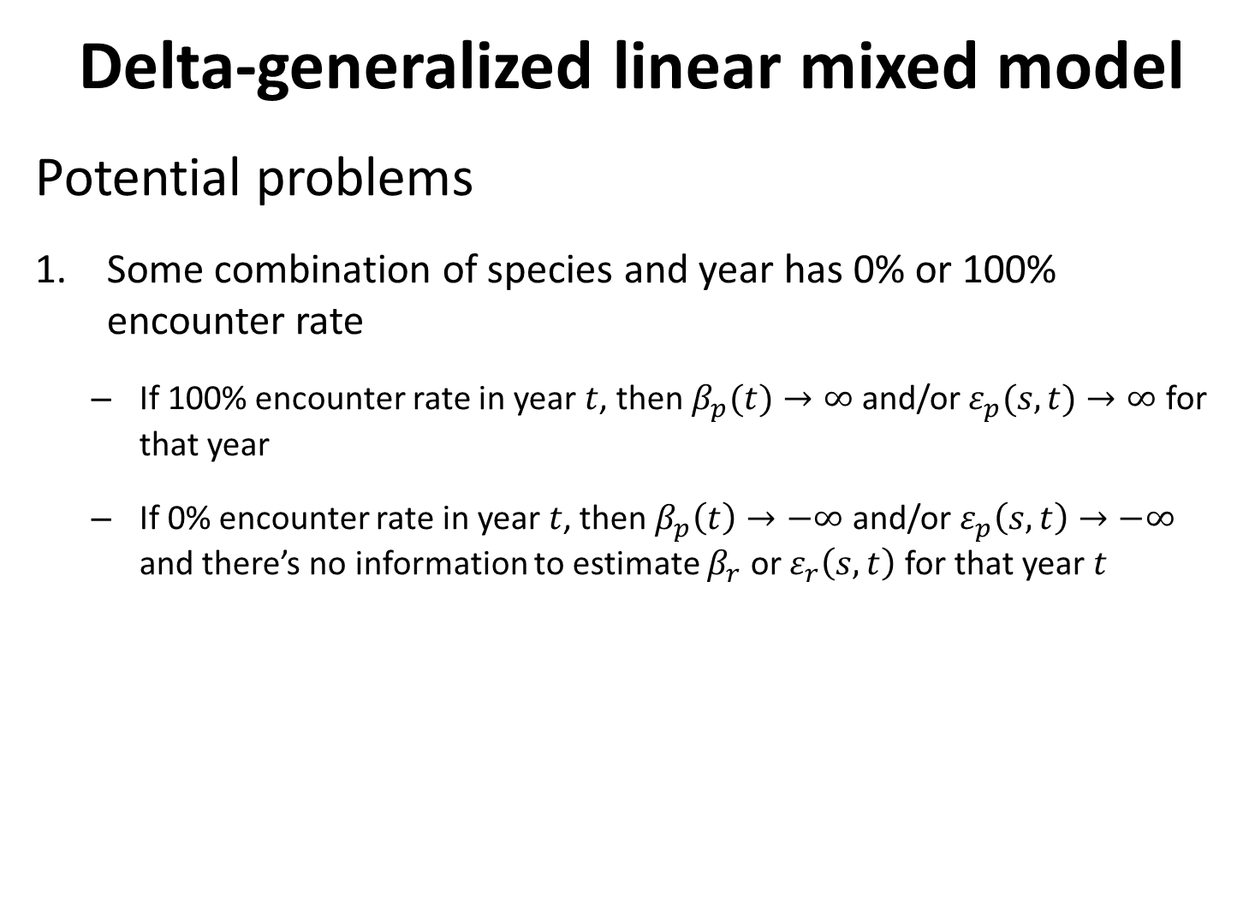
Delta-generalized linear mixed model
Potential problems
Some combination of species and year has 0% or 100% encounter rate
If 100% encounter rate in year $t$, then $β_{p}(t)→∞$ and/or $ε_{p}(s,t)→∞$ for that year
If 0% encounter rate in year $t$, then $β_{p}\left(t\right)→−∞$ and/or $ε_{p}\left(s,t\right)→−∞$ and there’s no information to estimate $β_{r}$ or $ε_{r}\left(s,t\right)$ for that year $t$

Slide 21
use ObsModel[2]=3
Delta-generalized linear mixed model
Potential problems
Some combination of species and year has 0% or 100% encounter rate
Solutions
If a few years with 100% encounter rate, try `ObsModel[2]=3`
indicates that VAST should check for species-years combinations with 100% encounter rates and fix those intercept for encounter probability to an extremely high value
If a few years with either 100% of 0% encounter rate, add temporal structure
Shrinks intercept and slope towards adjacent years
Four other special cases available

Slide 22
use ObsModel[2]=3
Delta-generalized linear mixed model
Potential problems
Parameters hit bounds
Solutions
Simplify model
Check parameter estimates when turning off standard errors and newtonstep
Identify parameter at bounds
E.g., ` ln_H_input` sometimes gets to strange values
Turn off using `Data_Fn( …, Aniso=FALSE )

Slide 23
use ObsModel[2]=3
Delta-generalized linear mixed model
Look at single-species example
https://github.com/James-Thorson/VAST/tree/master/examples]
[Work through broad structure together as class]

Slide 24
use ObsModel[2]=3
Delta-generalized linear mixed model
Look at multi-species example
https://github.com/James-Thorson/VAST/tree/master/examples]

